Slide 1
Iot
Reading / Writing analogue devices LED + Game-controller

Slide 2
Recapitulation
Start up the Raspberry Pi
Burn the image to SD-card
See / get access to the R-Pi – some problems to make the windows update DNS
https://github.com/adafruit/Adafruit-Pi-Finder
Try the Linux environment
Start of the Python programming
Simple GPIO access
Remember to use Pyhon3

Slide 3
LED light (RGB)

Slide 4
LED controls
Set RGB to on|off (True | False )
GPIO.setmode(GPIO.BCM)
GPIO.setup(14, GPIO.OUT)
GPIO.setup(15, GPIO.OUT)
GPIO.setup(18, GPIO.OUT)
GPIO.output(14, GPIO.LOW)
GPIO.output(15, GPIO.HIGH)
GPIO.output(18, GPIO.HIGH)
Set RGB to different level
PWM Pulse-Width Modulation
Could also be useful when working with motors

Slide 5
Pulse-Width Modulation
“Do you remember when you were a kid, how you sometimes flicked the light switch on and off repeatedly, really quickly, to see what would happen?
And you were told not to do it in case something bad happened (and it never did)? That was crude PWM.”
raspi.tv

Slide 6
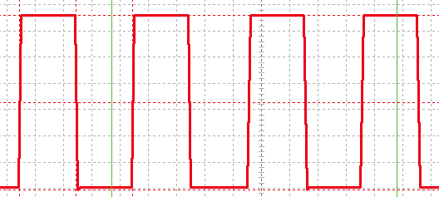
Pulse-Width Modulation
Frequency
Duty Cycle

Slide 7
PWM Python example
GPIO.setup(25, GPIO.OUT) ← set the pin to be output
p = GPIO.PWM(25, 50) ← activate PWM at 50 hertz (frequency)
p.start(50) ← start PWM with a 50% Duty Cycle
p.ChangeFrequency(100) ← Change frequency
p.ChangeDutyCycle(20) ← Set the Duty Cycle to 20%
p.stop()

Slide 8
Recapitulation
Start up the Raspberry Pi
Burn the image to SD-card
See / get access to the R-Pi – some problems to make the windows update DNS
https://github.com/adafruit/Adafruit-Pi-Finder
Try the Linux environment
Start of the Python programming
Simple CPIO access
Remember to use Pyhon3

Slide 9
NOW
Your turn to work

