Slide 1
Big Data
Intro

Slide 2
Examples - Volvo
Collect inf. of
road profile
Next time optimizing fuel consuming
http://etd.dtu.dk/thesis/191250/oersted_dtu2647.pdf

Slide 3
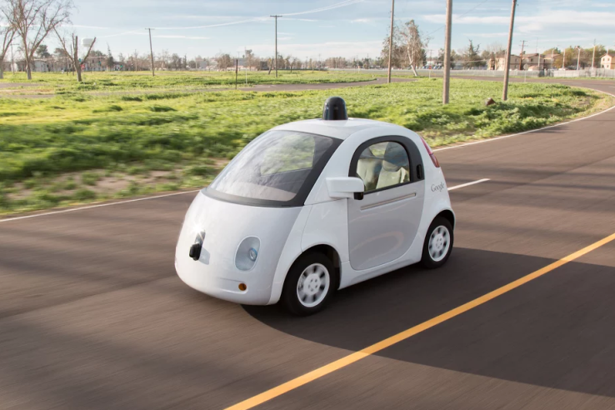
Examples - Google car
Collect all kind of
information
Self driving
https://techcrunch.com/2015/05/15/google-self-driving-cars-mountain-view/?ncid=rss&utm_source=feedburner&utm_medium=feed&utm_campaign=Feed%3A+Techcrunch+%28TechCrunch%29&utm_content=Google+International

Slide 4
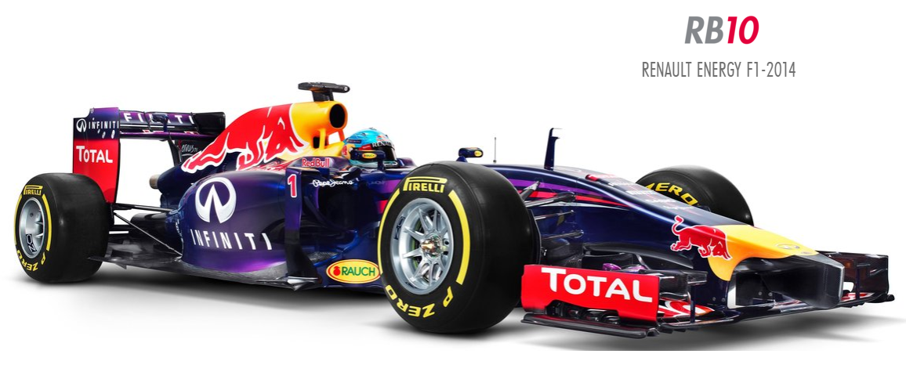
Examples - Formula 1 racing team ‘Red Bull‘
Several TB data in just one race
40-50 engineers analysing real time -> modify configuration
http://www.redbullracing.com/car/rb10

Slide 5




Examples - Social medias
Approx. 562.000.000 tweets / day
4.5 billion likes generated daily as of May 2013

Slide 6
What characterize Big Data
Volume - The quantity of generated and stored data.
Variety - The type and nature of the data. – structured / unstructured
Velocity - The speed at which the data is generated and processed.
Variability - Inconsistency of the data set can hamper processes to handle and manage it.
Veracity - The quality of captured data can vary greatly, affecting accurate analysis

Slide 7

Big Data implementations
Apache – Hadoop – most known
  Apache - https://hadoop.apache.org/
  Sandbox with bundled tools
    Hortonworks – http://hortonworks.com/products/sandbox/ -- We use this
    Cloudera – http://www.cloudera.com/downloads.html
Some others
  Oracle
  IBM – Watson – Beats Jeopardy world masters
  Microsoft

Slide 8
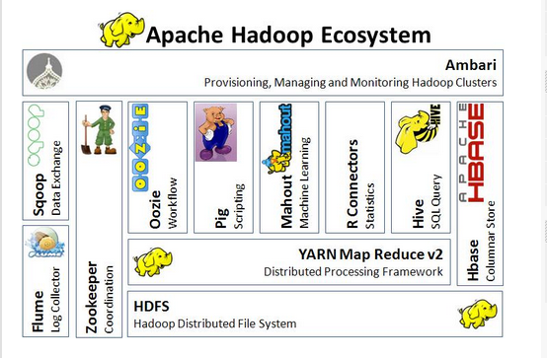
Hadoop architecture overview
http://www.dineshonjava.com/2014/11/hadoop-architecture.html#.WJJBxxsrLDc

Slide 9
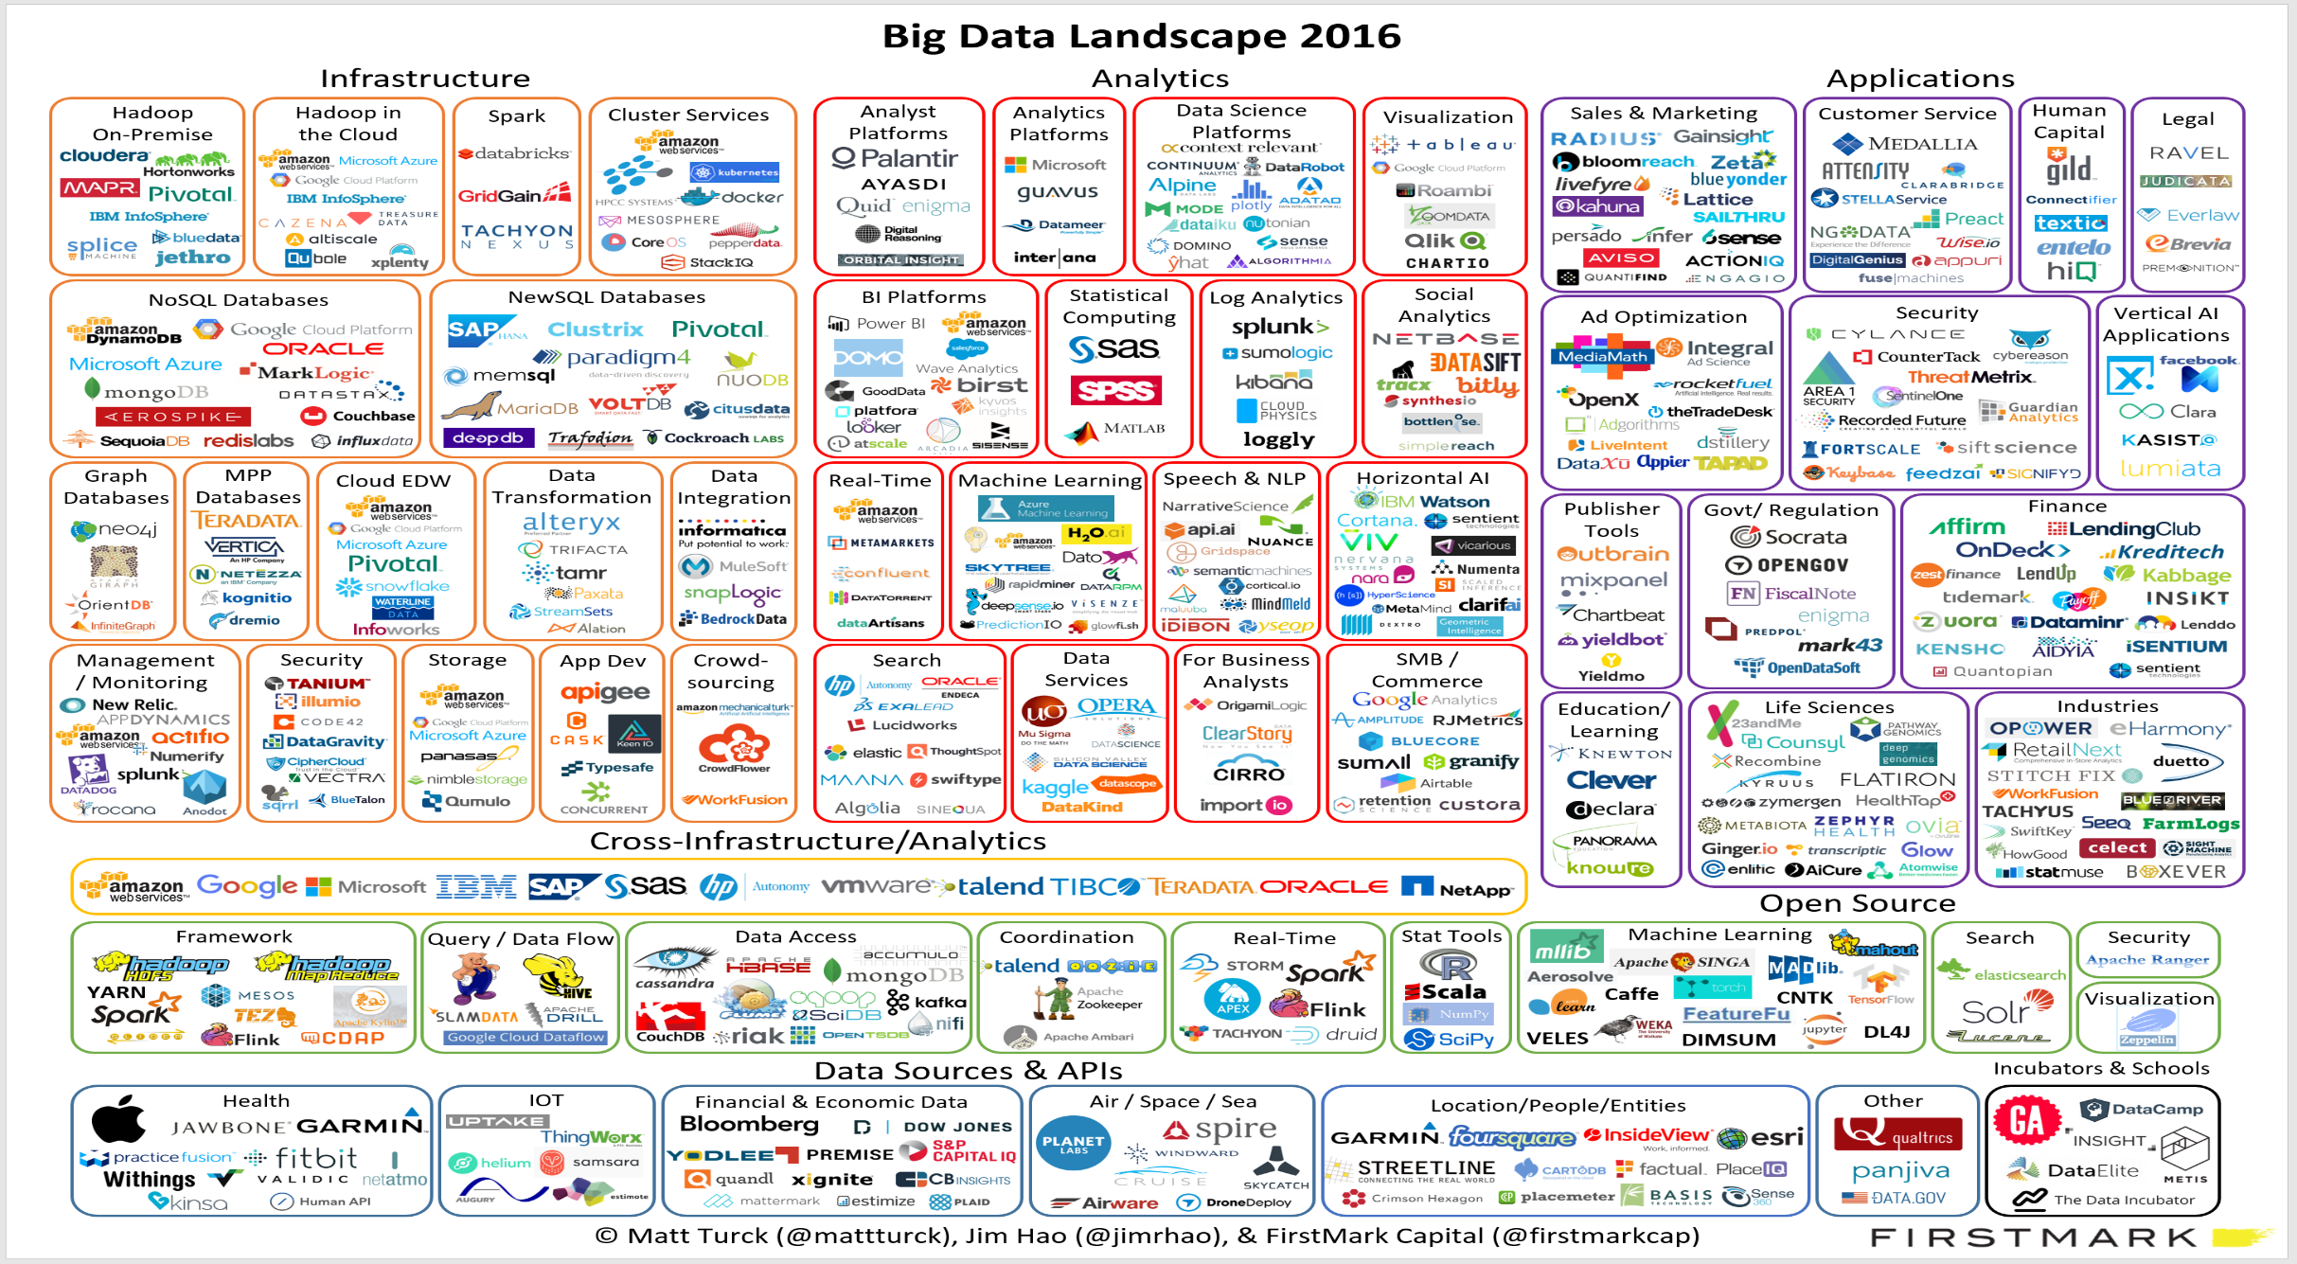
Full picture
https://www.mapr.com/why-hadoop/game-changer/overview
https://www.mapr.com/why-hadoop/game-changer/overview

Slide 10
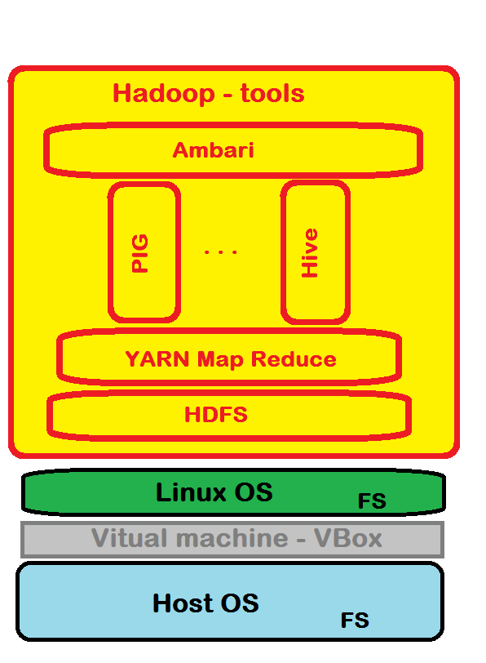
Our Architecture
HADOOP
* User interface – Ambari
* Analyzing / extracting tool – PIG, Hive
* Map Reduce (processing file request)
* Hadoop File System
System in sandbox
Linux (with a filesystem)
eg. RedHat with ext2
HOST OS (with a filesystem)
eg. Windows 10 with NTFS

Slide 11
Hive extract / insert data
HIVE data storage -> upon HDFS
Hive shell -> ’command prompt’ inside HIVE.
Metastore -> inf about the DB e.g. the DB it self, tables,
HiveQL -> SQL like interface
Hive Clients e.g. ODBC, JDBC

Slide 12
Hive Metastore
Holds information of different storage e.g.
  show database
  show tables
  describe ”table” -> show design of table

Slide 13
Hive Query Language -- HiveQL
SQl like interface
Create, insert, select
Example
Select * from xxxx where yy < 10

