Slide 1
Transport Layer
peterl

Slide 2
Transport level
application
transport
network
data link
physical
logical end-end transport
application
transport
network
data link
physical

Slide 3
Multiplexing/demultiplexing
multiplexing at sender:
handle data from multiple
sockets, add transport header (later used for demultiplexing)
demultiplexing at receiver:
use header info to deliver
received segments to correct
socket
application
application
P1
P2
application
socket
P3
transport
P4
process
transport
network
transport
network
link
network
link
physical
link
physical
physical

Slide 4
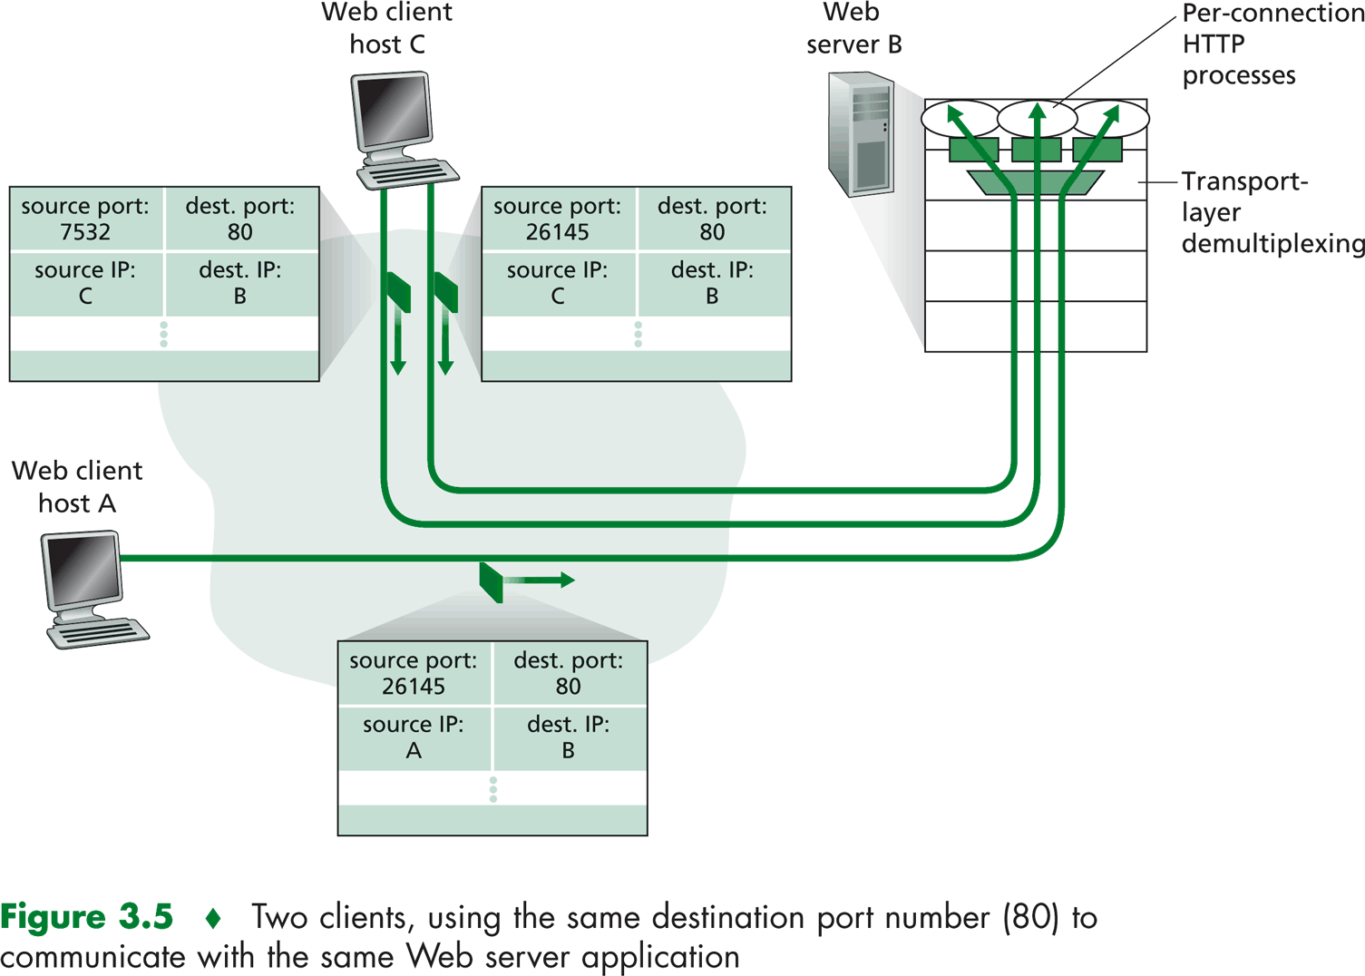

Slide 5
UDP: segment header
32 bits
source port #
dest port #
length
checksum
application
data
(payload)
UDP segment format

Slide 6
Internet checksum: example
example: add two 16-bit integers
1 1 1 1 0 0 1 1 0 0 1 1 0 0 1 1 0
1 1 1 0 1 0 1 0 1 0 1 0 1 0 1 0 1
1 1 0 1 1 1 0 1 1 1 0 1 1 1 0 1 1
1 1 0 1 1 1 0 1 1 1 0 1 1 1 1 0 0
1 0 1 0 0 0 1 0 0 0 1 0 0 0 0 1 1
wraparound
sum
checksum
Note: when adding numbers, a carryout from the most significant bit needs to be added to the result
Notes:
Kurose and Ross forgot to say anything about wrapping the carry and adding it to low order bit

Slide 7
TCP segment structure
32 bits
source port #
dest port #
sequence number
acknowledgement number
head
len
not
used
U
P
R
S
F
receive window
A
checksum
Urg data pointer
options (variable length)
application
data
(variable length)

Slide 8
TCP 3-way handshake
client state
server state
LISTEN
LISTEN
choose init seq num, x
send TCP SYN msg
SYNSENT
SYNbit=1, Seq=x
choose init seq num, y
send TCP SYNACK
msg, acking SYN
SYN RCVD
SYNbit=1, Seq=y
ACKbit=1; ACKnum=x+1
received SYNACK(x)
indicates server is live;
send ACK for SYNACK;
this segment may contain
client-to-server data
ESTAB
ACKbit=1, ACKnum=y+1
received ACK(y)
indicates client is live
ESTAB

Slide 9
rdt3.0 in action
sender
receiver
sender
receiver
send pkt0
pkt0
send pkt0
pkt0
rcv pkt0
rcv pkt0
ack0
send ack0
ack0
send ack0
rcv ack0
rcv ack0
send pkt1
pkt1
send pkt1
pkt1
rcv pkt1
X
ack1
send ack1
loss
rcv ack1
send pkt0
pkt0
rcv pkt0
timeout
resend pkt1
ack0
send ack0
pkt1
rcv pkt1
ack1
send ack1
rcv ack1
send pkt0
pkt0
(a) no loss
rcv pkt0
ack0
send ack0
(b) packet loss

Slide 10
rdt3.0 in action
sender
receiver
sender
receiver
send pkt0
pkt0
send pkt0
pkt0
rcv pkt0
rcv pkt0
ack0
send ack0
send ack0
rcv ack0
ack0
send pkt1
pkt1
rcv ack0
rcv pkt1
send pkt1
pkt1
send ack1
rcv pkt1
ack1
send ack1
ack1
X
loss
timeout
resend pkt1
pkt1
rcv pkt1
timeout
resend pkt1
rcv ack1
pkt1
rcv pkt1
pkt0
(detect duplicate)
send pkt0
send ack1
ack1
(detect duplicate)
ack1
rcv pkt0
rcv ack1
send ack1
rcv ack1
ack0
send ack0
pkt0
send pkt0
pkt0
send pkt0
rcv pkt0
rcv pkt0
ack0
(detect duplicate)
ack0
send ack0
send ack0
(c) ACK loss
(d) premature timeout/ delayed ACK

Slide 11
Go Back N

Slide 12
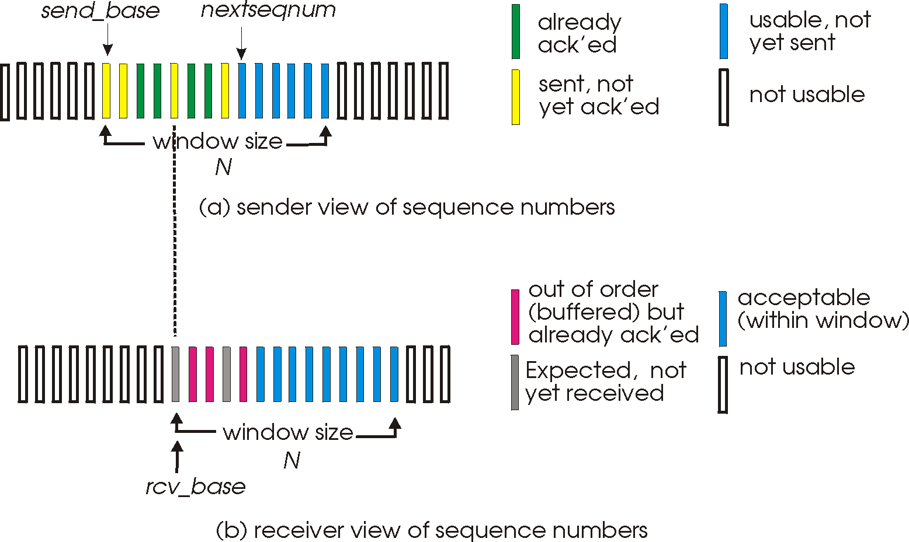
Selective Repeat

Slide 13
TCP segment structure
source port #
dest port #
sequence number
acknowledgement number
head
len
not
used
U
receive window
A
P
R
S
F
checksum
Urg data pointer
options (variable length)
application
data
(variable length)

Slide 14
TCP seq. numbers, ACKs
Host A
Host B
User
types
‘C’
Seq=42, ACK=79, data = ‘C’
host ACKs
receipt of
‘C’, echoes
back ‘C’
Seq=79, ACK=43, data = ‘C’
host ACKs
receipt
of echoed
‘C’
Seq=43, ACK=80
simple telnet scenario

Slide 15
