Slide 1
Computer - Historik

Slide 2
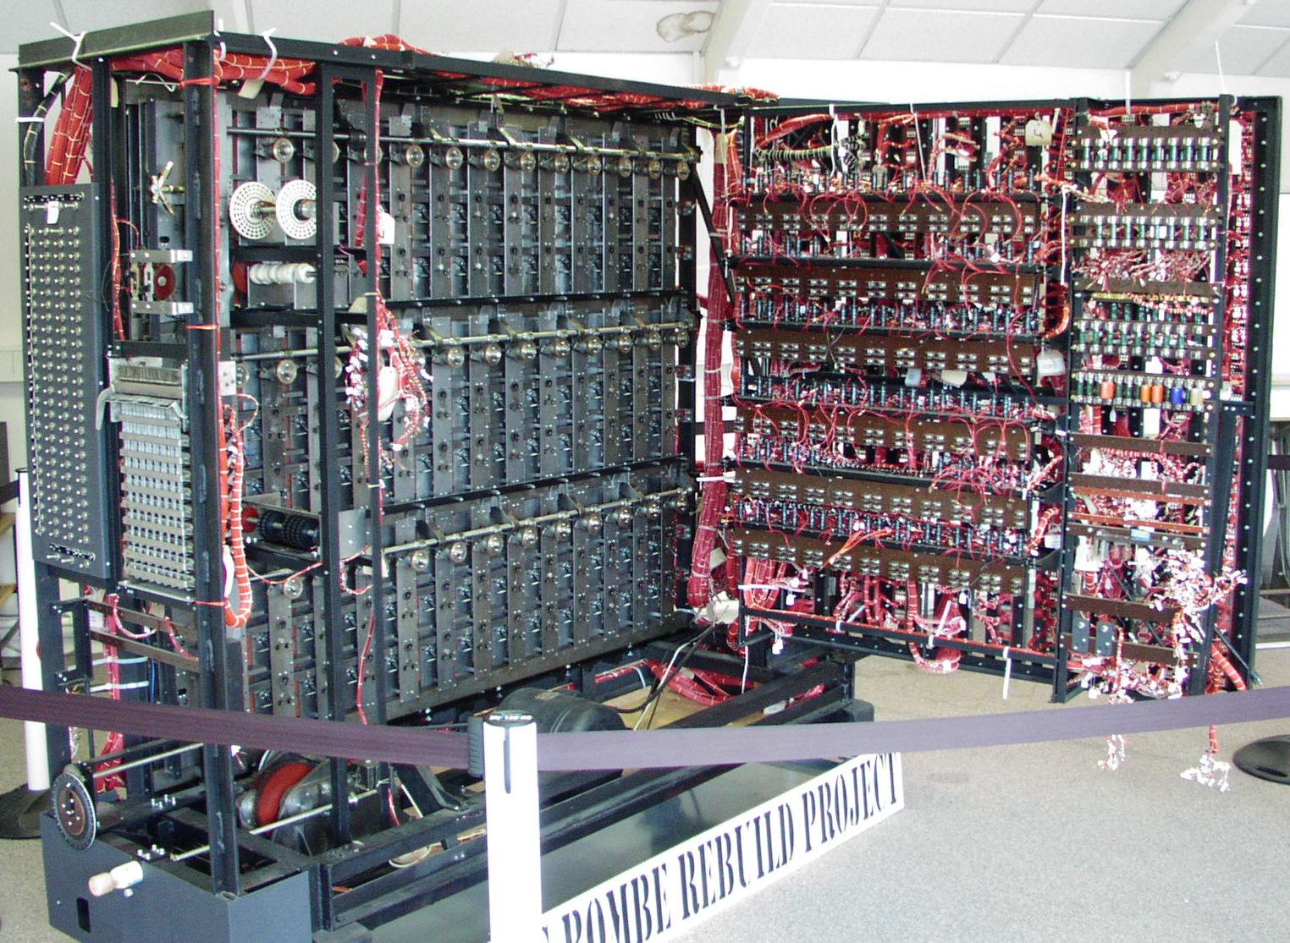
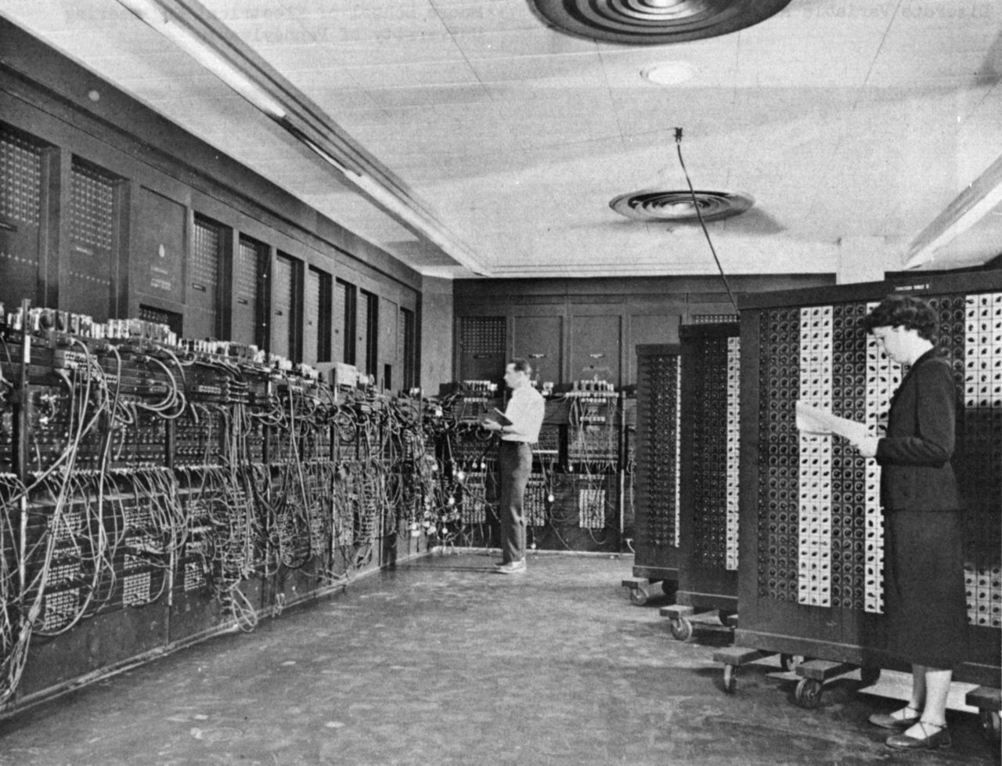
Before the electronic period
1600 PASCAL mechanical machine
1800 Punch Card Technology (weavers) – first known sabotage
1930 Alan Turing Theoretical Computing (Turing machine)
1940 Von Neumann Architecture of Computers
1944 WWII – England First Computer ENIAC – USA

Slide 3
1950-1960 : Mathematical + Science + (ADM)
No OS
No Language or assembler
No Net
Actor: IBM
Denmark: DASK

Slide 4
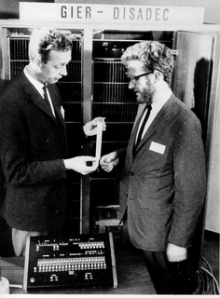
1960-1970 : Science + Administration (transistors)
OS: No OS (CICS - Multitasking)
Language: Assembler/CICS/Fortran/Algol
Net: SNA / (D)Arpa / X.25
Actor: IBM, Digital, HoneywellBull
Denmark: Gier / RC4000 Peter Naur – Backus-Naur notation + mem-paging

Slide 5
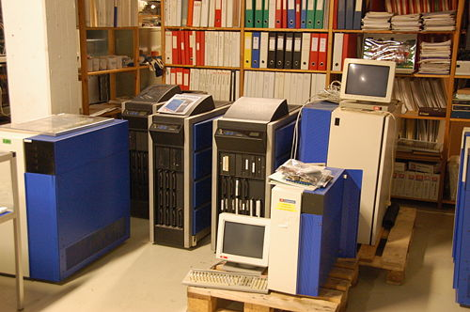
1970-1980 : Administration (IC)
OS: CICS, Unix
Language: CICS , C, Cobol
Net: SNA / X.25(Minitel) / Ethernet Internet(ARPA), IP(1972/1975),Email(1975/1976)
Actor: IBM, DEC
Processor Intel 8086-80286 (16 bit bus)
Denmark: RC8000, DDE-Supermax, Rovsing-CR80

Slide 6
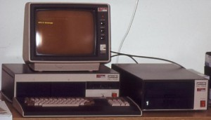
1980-1990 : Administration + PC
OS: CICS, Unix, DOS(‘windows’), OS-X
Language: High level – C, C++, Pascal
Net: ‘internet’-familien
Actor: Microsoft, Compact, HP, SUN, IBM
Processor Intel 80386-80586/pentium (32 bit bus x86)
Denmark: Partner/RC900, Piccoline/Piccolo, DDE, Rovsing Bjarne Staustrup C++

Slide 7
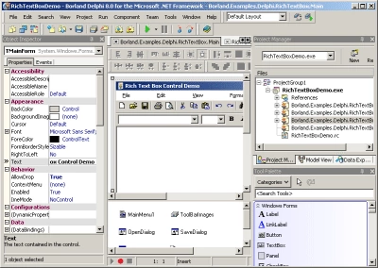
1990-2000 : Personal
OS: Windows, Unix/Linux, OS-X C++, Java, C#, Delphi
Net: Internet, ADSL
Actor: Micrsoft
Processor: Intel 80586(Pentium4->) 32 bit (x86)
Denmark: Navision (Erik+Preben Damgaard) Anders Hejlsberg - IDE

Slide 8
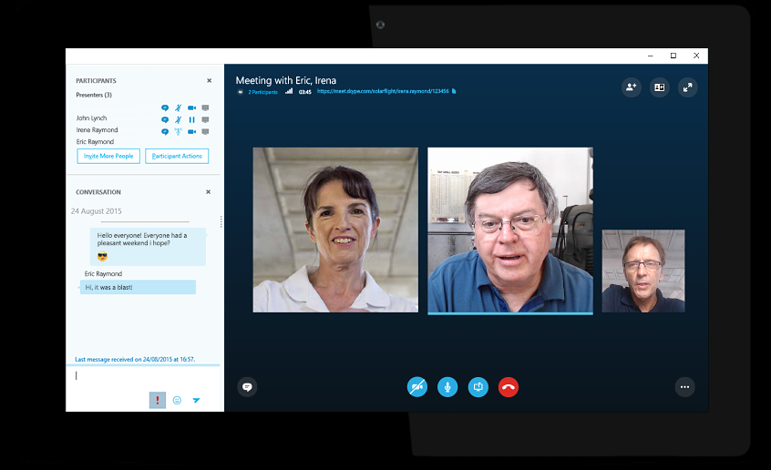
2000-2010 : Personal/Net
OS: Windows, Linux, OS-X
Language: Java, C#
Net: Internet, Wifi
Actor: Micrsoft, Google, Apple
Processor: Intel core 64 bit (x64)
Denmark: Skype Janus Friis

Slide 9
2010-2020 : Mobile / Cloud
OS: IOS, Android Windows, Unix/Linux, OS-X
Language: C#, Java, Objective-C/Swift, node.JS ….?
Net: Internet, 4/5G net ….?
Actor: Google, Apple, Microsoft, Facebook, Amazone ….?
Denmark: ….?

Slide 10
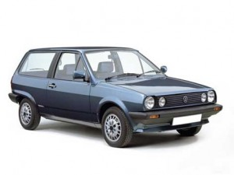
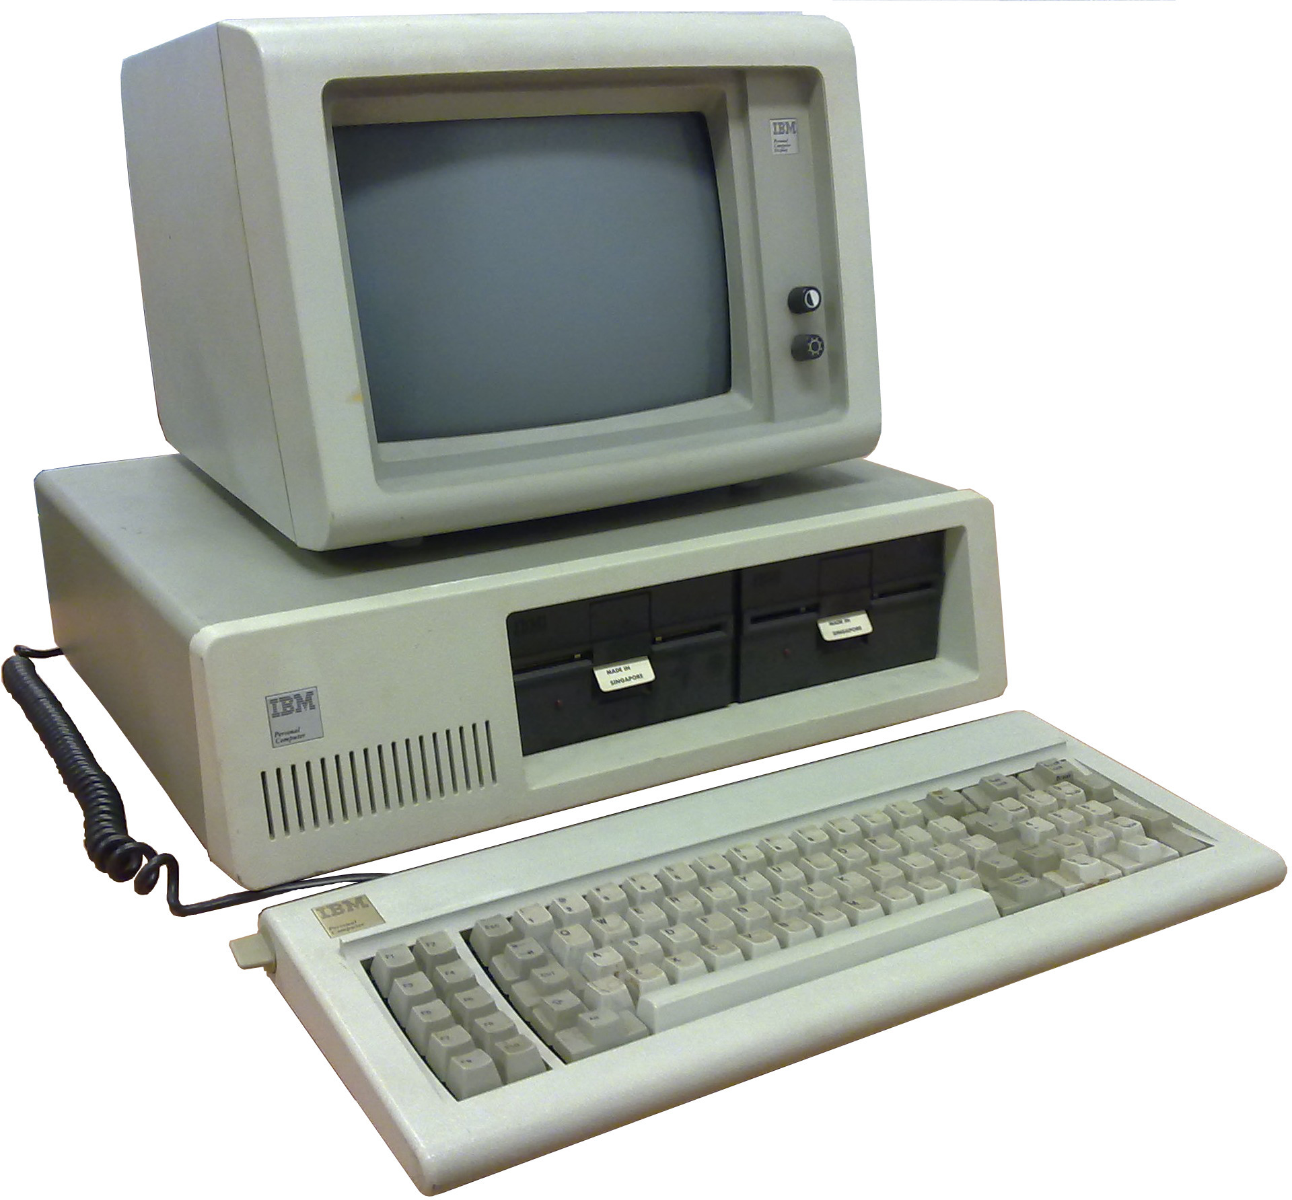
History Exercise
Assume the development within cars have followed computers
1982 – The first ‘PC’ in Denmark
1982 – The first VW Polo in Denmark
1982
Memory in RAM
CPU frequency
Disk
2017
Memory in RAM
CPU frequency
Disk
1982
No Of Seats 4
Top Speed 167 Km/h
Cargo 400 Kg
2017
No Of Seats ???
Top Speed ???
Cargo ???
Same progress

