Slide 1
Quality Factors

Slide 2
Hvad er Kvalitet?
Conformance to specification: Quality that is defined as a matter of products and services
Meeting customer needs: Quality that is identified independent of any measurable characteristics.

Slide 3
Hvad er Kvalitet? Del 2
Walter A. Shewhart defines quality
The consideration of the quality of a thing as an objective reality independent of the existence of man. (Kvantitative – tit tæt på kvalitets faktorer)
What we think, feel or sense as a result of the objective reality. In other word, there is a subjective side of quality. (Kvalitative – sværere at beskrive)

Slide 4
Kvalitet faktorer
Et redskab til
Et bedre system udvikling forløb
Et fokuseret system udvikling forløb
Afklare bruger krav
Bør indgå i krav specifikationen
NB! Det er nemmere at specificere ‘objektive’ krav end subjektive

Slide 5
Kvalitet faktorer DEL 2
En række Kvalitets Modeller
McCall (conform to specification)
Boehm (You can conform in diff. degree)
FURPS (Same but fewer categories – Described in Larman)
ISO – international Standardisation Organisation
900x – focus on process
9126 – a la McCall, Boehm, FURPS
25010 – Newest version of SW Product Quality

Slide 6
McCall - Major Perspectives
Portability kan det køre på andre platforme
Reusability kan jeg genbruge dele af SW
Interoperability kan det kobles til andre systemer
Maintability Kan jeg rette i det
Flexsability Kan det ændres
Testability Kan det testes
Product Revision
Product Transition
Product Operation
Correctness Gør vi det rigtigt
Reliability Gør vi det nøjagtigt hele tiden
Efficiency Kører det optimalt på min HW
Integrity Er det sikkert
Usability Kan jeg køre det (brugervenligt)

Slide 7
McCall - Kvalitets Faktorer
Correctness
Reliability
Efficiency
Integrity
Usability
Maintainability
Testability
Flexibility
Portability
Reusability
Interoperability

Slide 8
Product Operation

Slide 9
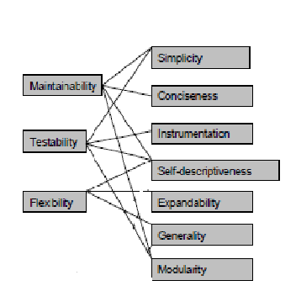
Product Revision

Slide 10
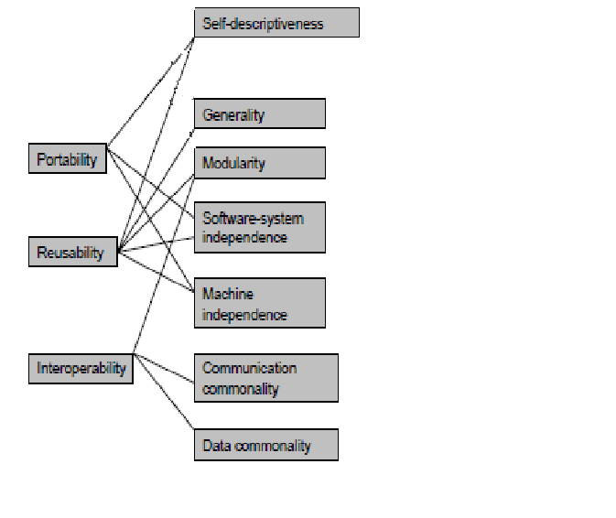
Product Transition

Slide 11
FURPS
Functional features, capabilities, security.
Usability human factors, help, documentation.
Reliability frequency of failure, recoverability, predictability.
Performance response times, throughput, accuracy, availability, resource usage.
Supportability adaptability, maintainability, internationalization, configurability.

Slide 12
FURPS+
Implementation resource limitations, languages and tools, hardware, ...
Interface constraints imposed by interfacing with external systems.
Operations system management in its operational setting.
Packaging for example, a physical box.
Legal licensing and so forth.

Slide 13
ISO - 26010
Source:: http://iso25000.com/index.php/en/iso-25000-standards/iso-25010?limit=3&limitstart=0

Slide 14
ISO – 26010 – Functional Suitability
Functional completeness.
Degree to which the set of functions covers all the specified tasks and user objectives.
Functional correctness.
Degree to which a product or system provides the correct results with the needed degree of precision.
Functional appropriateness.
Degree to which the functions facilitate the accomplishment of specified tasks and objectives.
Source:: http://iso25000.com/index.php/en/iso-25000-standards/iso-25010?limit=3&limitstart=0

Slide 15
ISO – 26010 – Performance efficiency
Time behaviour. Degree to which the response and processing times and throughput rates of a product or system, when performing its functions, meet requirements.
Resource utilization. Degree to which the amounts and types of resources used by a product or system, when performing its functions, meet requirements.
Capacity. Degree to which the maximum limits of a product or system parameter meet requirements.
Source:: http://iso25000.com/index.php/en/iso-25000-standards/iso-25010?limit=3&limitstart=0

Slide 16
ISO – 26010 – Compatibility
Co-existence. Degree to which a product can perform its required functions efficiently while sharing a common environment and resources with other products, without detrimental impact on any other product.
Interoperability. Degree to which two or more systems, products or components can exchange information and use the information that has been exchanged.
Source:: http://iso25000.com/index.php/en/iso-25000-standards/iso-25010?limit=3&limitstart=0

Slide 17
ISO – 26010 – Usability
Appropriateness recognisability. Degree to which users can recognize whether a product or system is appropriate for their needs.
Learnability. Degree to which a product or system can be used by specified users to achieve specified goals of learning to use the product or system with effectiveness, efficiency, freedom from risk and satisfaction in a specified context of use.
Operability. Degree to which a product or system has attributes that make it easy to operate and control.
User error protection. Degree to which a system protects users against making errors.
User interface aesthetics. Degree to which a user interface enables pleasing and satisfying interaction for the user.
Accessibility. Degree to which a product or system can be used by people with the widest range of characteristics and capabilities to achieve a specified goal in a specified context of use.
Source:: http://iso25000.com/index.php/en/iso-25000-standards/iso-25010?limit=3&limitstart=0

Slide 18
ISO – 26010 – Reliability
Maturity. Degree to which a system, product or component meets needs for reliability under normal operation.
Availability. Degree to which a system, product or component is operational and accessible when required for use.
Fault tolerance. Degree to which a system, product or component operates as intended despite the presence of hardware or software faults.
Recoverability. Degree to which, in the event of an interruption or a failure, a product or system can recover the data directly affected and re-establish the desired state of the system.
Source:: http://iso25000.com/index.php/en/iso-25000-standards/iso-25010?limit=3&limitstart=0

Slide 19
ISO – 26010 – Security
Confidentiality. Degree to which a product or system ensures that data are accessible only to those authorized to have access.
Integrity. Degree to which a system, product or component prevents unauthorized access to, or modification of, computer programs or data.
Non-repudiation. Degree to which actions or events can be proven to have taken place, so that the events or actions cannot be repudiated later.
Accountability. Degree to which the actions of an entity can be traced uniquely to the entity.
Authenticity. Degree to which the identity of a subject or resource can be proved to be the one claimed.
Source:: http://iso25000.com/index.php/en/iso-25000-standards/iso-25010?limit=3&limitstart=0

Slide 20
ISO – 26010 – Maintainability
Modularity. Degree to which a system or computer program is composed of discrete components such that a change to one component has minimal impact on other components.
Reusability. Degree to which an asset can be used in more than one system, or in building other assets.
Analysability. Degree of effectiveness and efficiency with which it is possible to assess the impact on a product or system of an intended change to one or more of its parts, or to diagnose a product for deficiencies or causes of failures, or to identify parts to be modified.
Modifiability. Degree to which a product or system can be effectively and efficiently modified without introducing defects or degrading existing product quality.
Testability. Degree of effectiveness and efficiency with which test criteria can be established for a system, product or component and tests can be performed to determine whether those criteria have been met.
Source:: http://iso25000.com/index.php/en/iso-25000-standards/iso-25010?limit=3&limitstart=0

Slide 21
ISO – 26010 – Portability
Adaptability. Degree to which a product or system can effectively and efficiently be adapted for different or evolving hardware, software or other operational or usage environments.
Installability. Degree of effectiveness and efficiency with which a product or system can be successfully installed and/or uninstalled in a specified environment.
Replaceability. Degree to which a product can replace another specified software product for the same purpose in the same environment.
Source:: http://iso25000.com/index.php/en/iso-25000-standards/iso-25010?limit=3&limitstart=0

