Slide 1
User Interface Design
In Windows using Blend

Slide 2
General UI guidelines 10 heuristics (Jakob Nielsen)
Visibility of system status
Match between system and the real world
User control and freedom
Consistency and standards
Error prevention
Recognition rather than recall
Flexibility and efficiency of use
Aesthetic and minimalist design
Help users recognize, diagnose, and recover from errors
Help and documentation

Slide 3
Examples illustrating the 10 Heuristics
Source: J.Nielsen own homepage
http://www.nngroup.com/articles/ten-usability-heuristics/
Illustrated:
http://www.slideshare.net/crafted/10-usability-heuristics-explained
Short Illustrated version:
http://www.slideshare.net/sacsprasath/ten-usability-heuristics-with-example
Explaining short version:
http://www.whatwasithinking.co.uk/2009/02/27/explaining-usability-heuristics-a-quick-guide/

Slide 4
Windows Guidelines – Modern Design
5 principles of designs is the foundation of modern design
Pride in craftsmanship
Fast and fluid
Authentically digital
Do more with less
Win as one

Slide 5
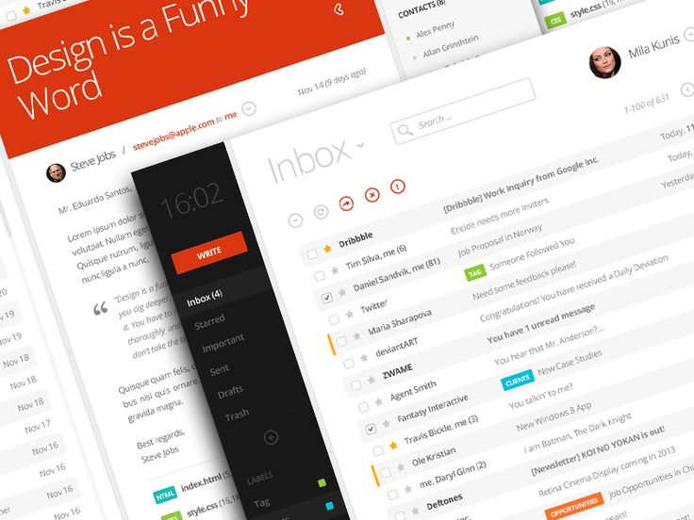
Pride in craftmanship
Sweet the pixel details
Make sure everything is aligned and well balanced
Create a pure design

Slide 6
Be fast and fluid
Use motion to make our app spring alive
Use the built-in transitions well
Use animation wisely

Slide 7
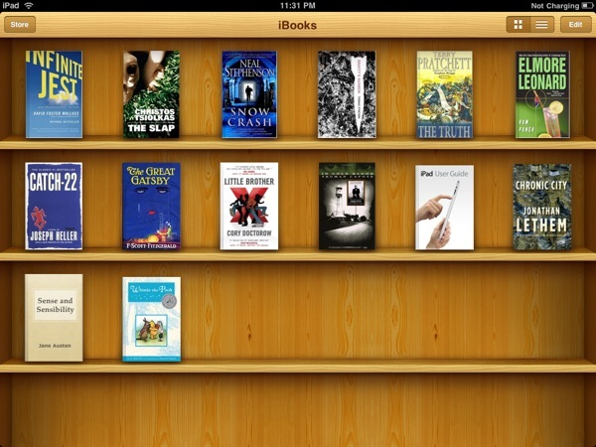
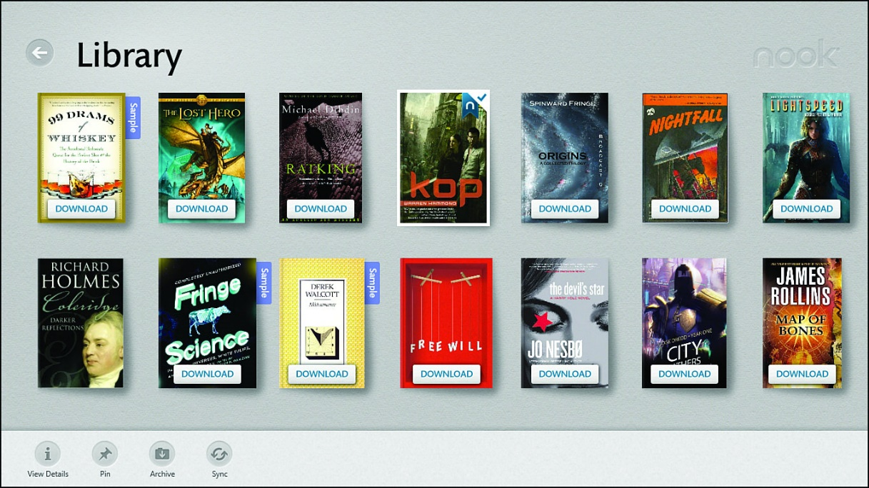
Authentically digital
From skeumorphism to a pure flat bauhaus inspired UI. Modern UI and Microsoft started it. Apple IOS followed.

Slide 8
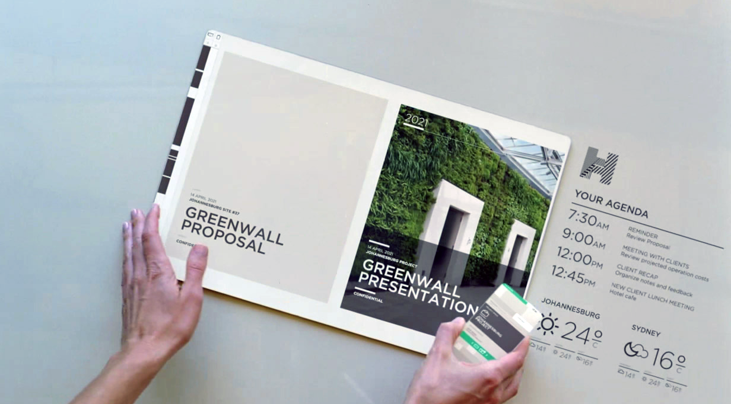
Do more with less
Based on ”less is more” from Bauhaus
Remove all unneccesarities
Make it simple and pure

Slide 9
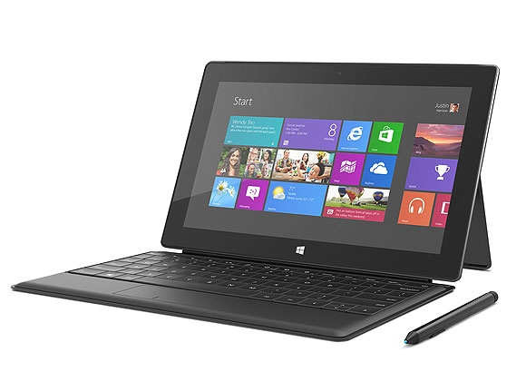
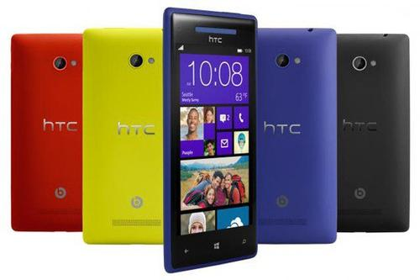
Win as one
Share your design philosophy across all platforms
Re-use and empower your development and design process
+60% reuseability

Slide 10
Microsofts’ 5 principles - Translated
Content before chrome
Create flat & recognizable design
Keep it simple
Design with bold, vibrant and crisp colors and images that go beyond the limits of real world material.

Slide 12
Universal Windows Platform

Slide 13
Windows Device Families

Slide 14
Choosing the right tool
VS == code
Blend == layout
Beginners => Easy Start
Advanced => High Productivity

Slide 15
Techniques for good (ms-) design
General principles – put into rules of thumbs
Organize the screen
AppBars (‘hide’ functionality)
Other utilities

Slide 16
Organize the screen - Size and proportion
1
2
3
Notes:
Estimated Time: 3 minutes
Key Messages:
Break out of standard template.
Use size and proportion.
Script:
In your app, you will want to drive people’s focus to certain elements on the page. You can do this using size and proportion or by varying the position of objects on the page.
Transition: [Next, Position]

Slide 17
AppBars - (‘hide’ functionality)
Primary Commands
always visible => often used functionalities
Secondary Commands
only visible when tap/click the field ‘…’
Secondary Commands
Primary Commands

Slide 18
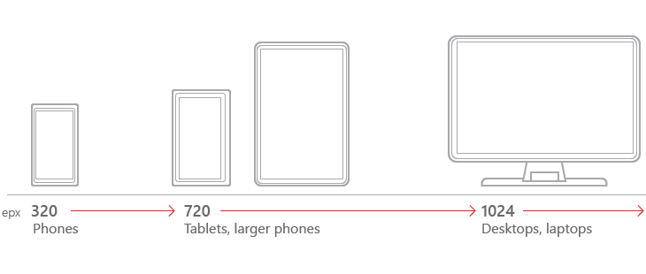
Other utilities
Different size classes

Slide 19
Other utilities see https://msdn.microsoft.com/en-us/library/windows/apps/hh465424.aspx
Animations
App settings and data
Controls and patterns
Custom user interactions
Files, data, and connectivity
Globalization and localization
Help and instructions
Identity and security
Launch, suspend, and resume
Layout and scaling
Maps and location
Text and input
Tiles and notifications

Slide 20
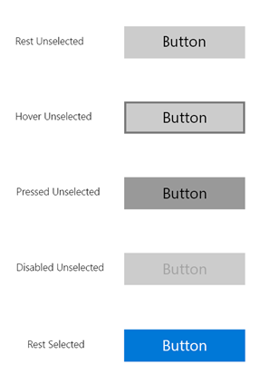
Other utilities – e.g. Controls and patterns
Following these guidelines will help you provide a consistent, elegant, and compelling user experience.
A button gives the user a way to trigger an immediate action.
Example of buttons

Slide 21
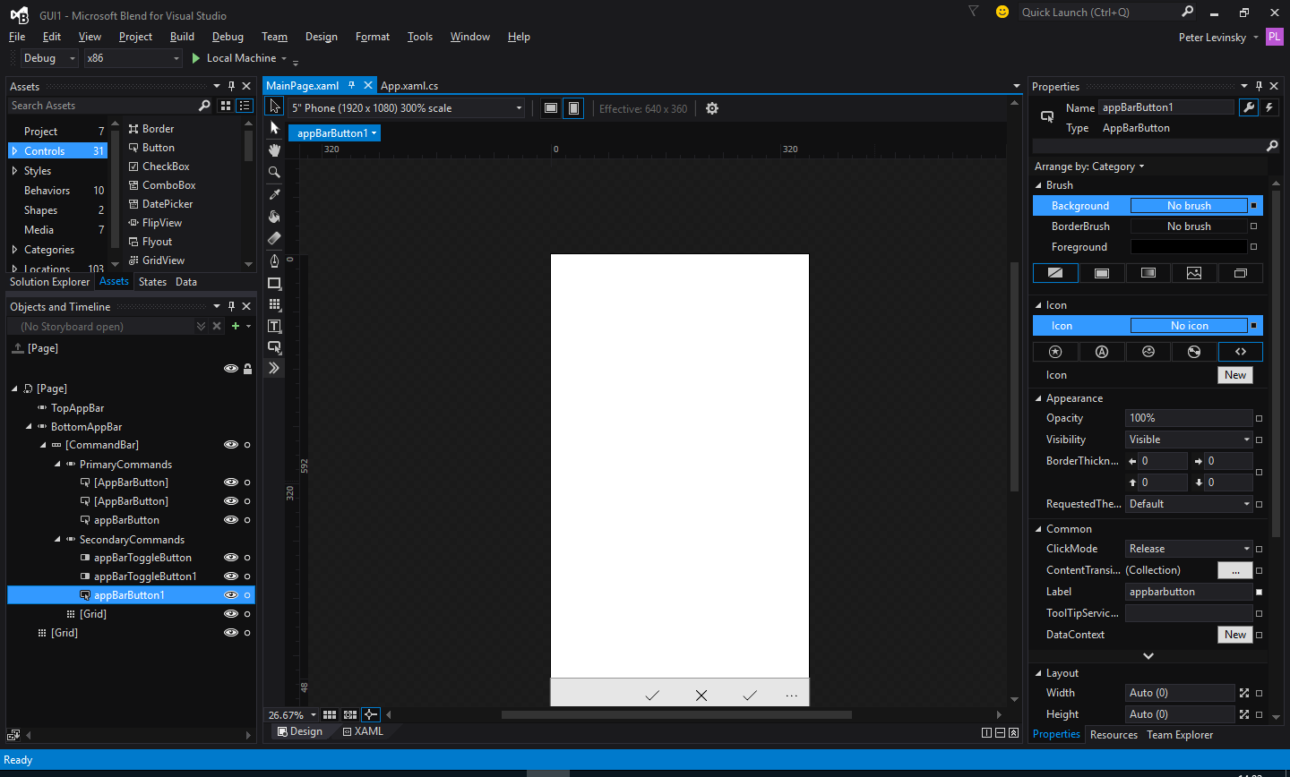
Very Short overview of BLEND
Whistles
Bells
The GUI
Ex: phone GUI
Toolbox / assets
Find controls and behaviors
Properties
Setting values like colours,
Shape, size etc
Objects and Timelines
Element structure(as a tree)
In the GUI

