Slide 1

Analyse værktøjer til Virksomheden

Slide 2
The Business Model Generation - Canvas
The 9 Building Blocks

Slide 3
Analyse (Bizz Canvas,swot, …)
Plan retning (andre end jer)
Plan strategi (andre end jer)
Implementering (Bizz Case)

Slide 4
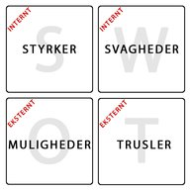
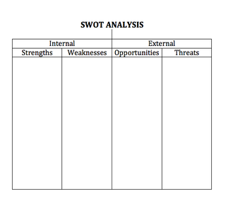
SWOT

Slide 5
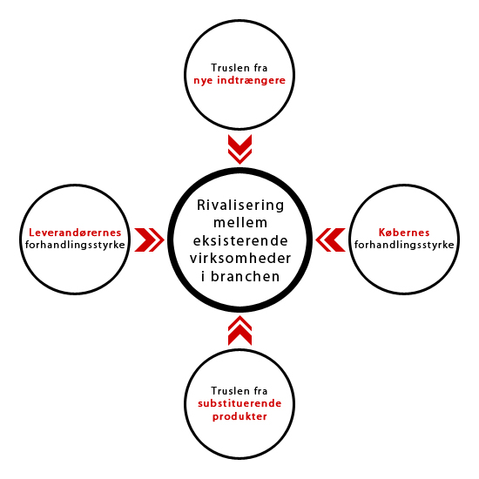
Porters
5 Forces

Slide 6
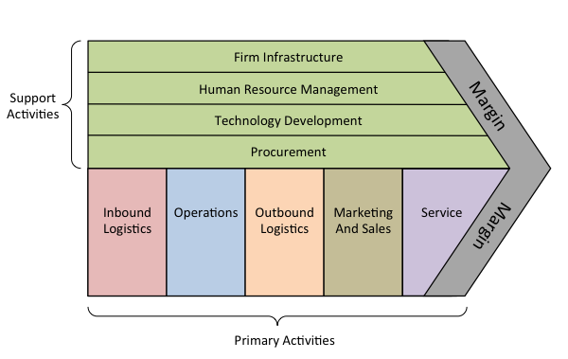
Porters Value Chain

Slide 7
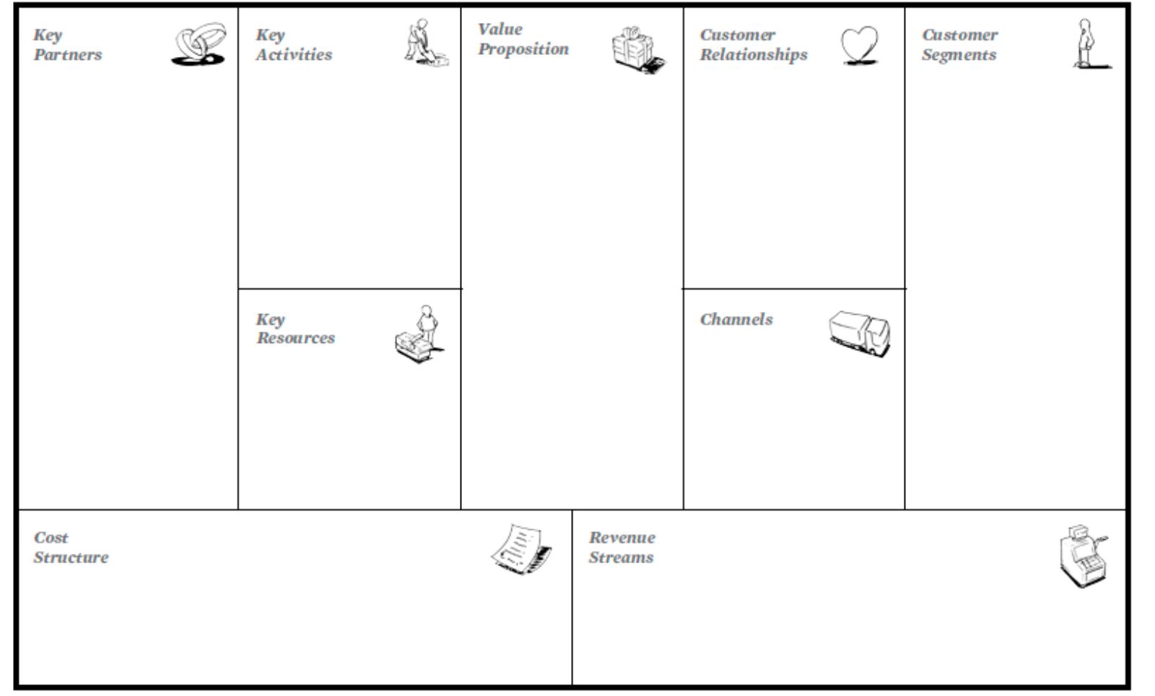
Back to Business Generation Model Canvas

