Slide 1
User Interface Design

Slide 2
General UI guidelines 10 heuristics (Jakob Nielsen)
Visibility of system status (progress bar, time glass, dots)
Match between system and the real world (users' language, with words, phrases)
User control and freedom (“Go back” button, “Undo” button)
Consistency and standards (use same name for same function)
Error prevention (which fields are mandatory, form validation, dropdown boxes)
Recognition rather than recall (“please select from a list of options”, “Did you mean…”, tool-tips or help icons)
Flexibility and efficiency of use (quick-links, “saved searches”, “items you recently looked at”, “save query for later”)
Aesthetic and minimalist design (clear call to actions, no annoying flashing eye-candy)
Help users recognize, diagnose, and recover from errors (Useful error messages, plain language)
Help and documentation (FAQs, “?” icons)

Slide 3
Examples illustrating the 10 Heuristics
Source: J.Nielsen own homepage
http://www.nngroup.com/articles/ten-usability-heuristics/
Illustrated:
http://www.slideshare.net/crafted/10-usability-heuristics-explained
Short Illustrated version:
http://www.slideshare.net/sacsprasath/ten-usability-heuristics-with-example
Explaining short version:
http://www.whatwasithinking.co.uk/2009/02/27/explaining-usability-heuristics-a-quick-guide/

Slide 4
Windows Guidelines – Modern Design
5 principles of designs is the Foundation of modern design
Pride in craftsmanship
Fast and fluid
Authentically digital
Do more with less
Win as one

Slide 5
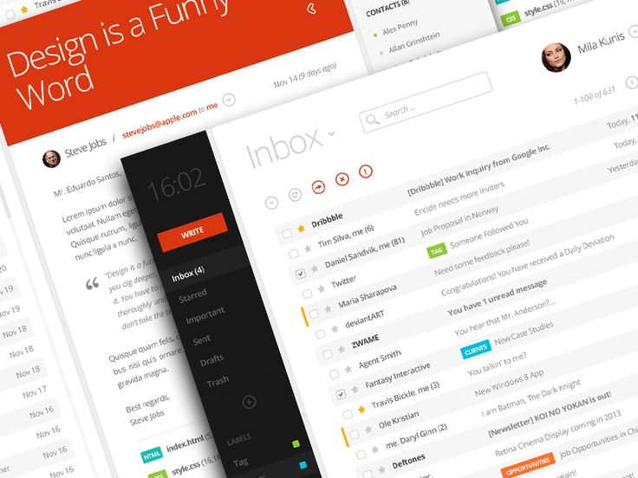
Pride in craftmanship
Sweet the pixel details
Make sure everything is aligned and well balanced
Create a pure design

Slide 6
Be fast and fluid
Use motion to make our app spring alive
Use the built-in transitions well
Use animation wisely

Slide 7
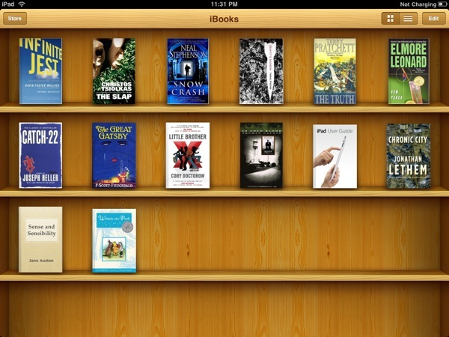
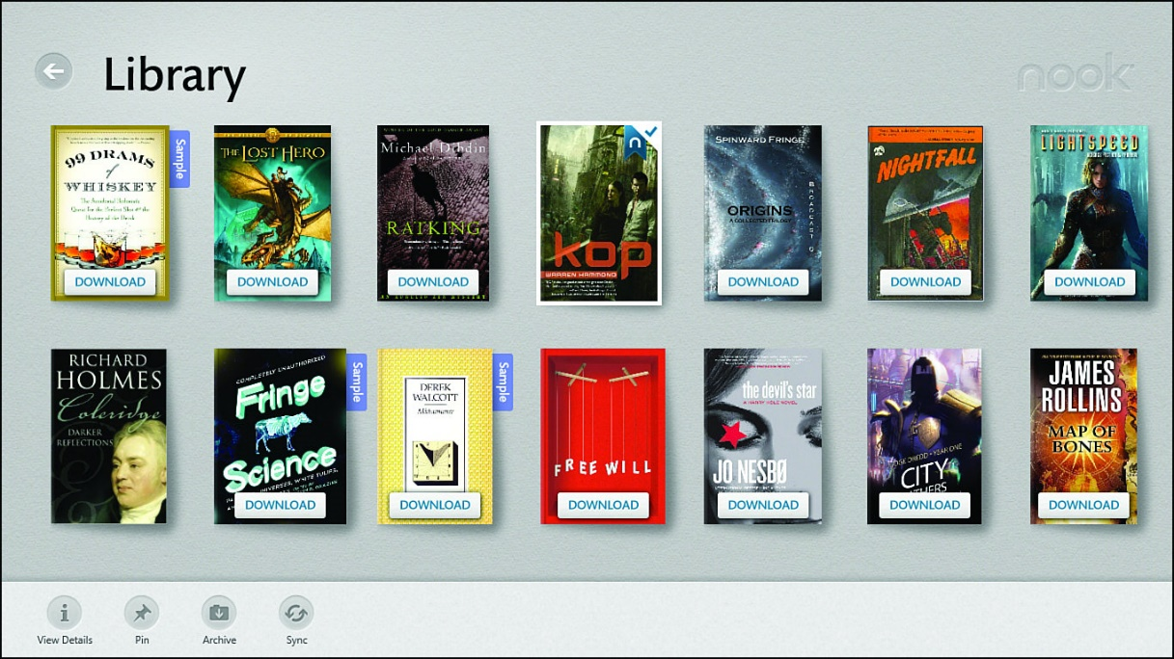
Authentically digital
From skeumorphism to a pure flat bauhaus inspired UI.

Slide 8
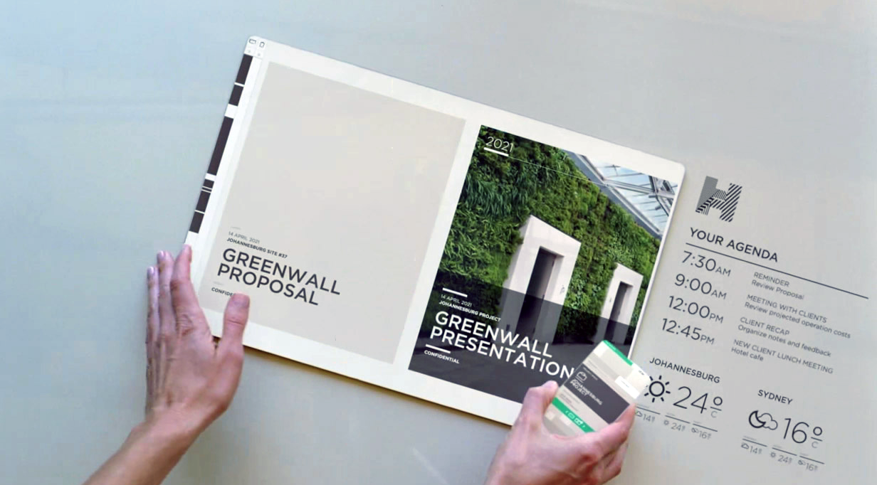
Do more with less
Based on ”less is more” from Bauhaus
Remove all unneccesarities
Make it simple and pure

Slide 9
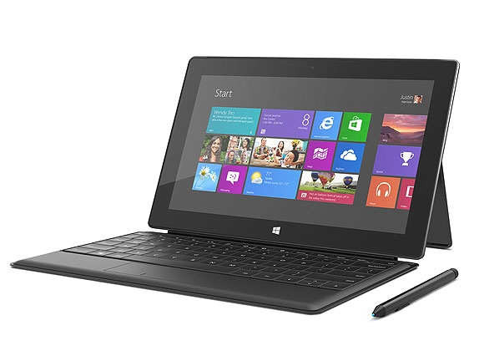
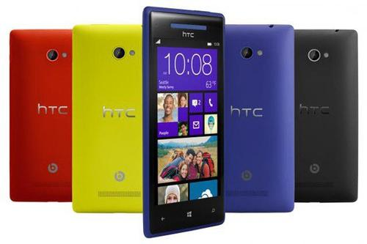
Win as one
Share your design philosophy across all platforms
Re-use and empower your development and design process
+60% reuseability

Slide 10
Microsofts’ 5 principles - Translated
Content before chrome
Create flat & recognizable design
Keep it simple
Design with bold, vibrant and crisp colors and images that go beyond the limits of real world material.

