Slide 1
Software Testing

Slide 2
Kvalitets faktorer
Portability kan det køre på andre platforme
Reusability kan jeg genbruge dele af SW
Interoperability kan det kobles til andre systemer
Maintability Kan jeg rette i det
Flexsability Kan det ændres
Testability Kan det testes
Product Revision
Product Transition
Product Operation
Correctness Gør vi det rigtigt
Reliability Gør vi det nøjagtigt hele tiden
Efficiency Kører det optimalt på min HW
Integrity Er det sikkert
Usability Kan jeg køre det (brugervenligt)

Slide 3
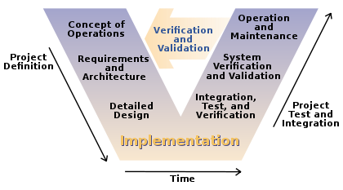
V model

Slide 4
Program testing goals
To demonstrate to the developer and the customer that the software meets its requirements. => leads to validation testing
To discover situations in which the behavior of the software is incorrect, undesirable or does not conform to its specification. => leads to defect testing

Slide 5
Verification vs validation
Verification: (testing) "Are we building the product right”.
The software should conform to its specification.
Validation: (checking) "Are we building the right product”.
The software should do what the user really requires.

Slide 6
V model

Slide 7
Different levels of testing related to the V-model
Verify the concepts and requirements e.g. Are the domain model right? The use cases? (the users)
Verify the design e.g. design class diagrams and design sequence diagrams (Reviews, Technical walkthrough by the project team)
Component Validation e.g. unit test and test cases (implementer)
System and integration validation e.g. system/integration test
Operation Validation e.g. acceptance test

Slide 10
Black box testing
The system code is ‘unknown’ -> a black box
Look only at the methods signatures
Testing all kind of possible input and output
In C# create a Unit Test

Slide 11
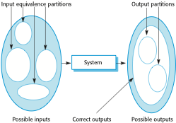
Equivalence partitioning

Slide 12
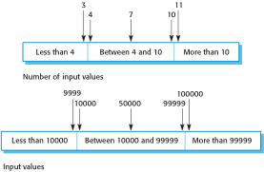
Equivalence partitions

Slide 13
Test-driven development
Test-driven development (TDD) is an approach to program development in which you inter-leave testing and code development.
Tests are written before code and ‘passing’ the tests is the critical driver of development.
You develop code incrementally, along with a test for that increment. You don’t move on to the next increment until the code that you have developed passes its test.
TDD was introduced as part of agile methods such as Extreme Programming. However, it can also be used in plan-driven development processes.

Slide 14
Test-driven development

Slide 15
Unit test in c#
Console Programs
Create a test unit project,
Add reference to the project,
Remember to have the class to be tested public. (in resharper set cursor at the class – right click choose generate unit test)
Make a test method for each test case
App Programs
Create a unit test app (universal windows),
Add reference to the project,
Remember to have the class to be tested public. (in resharper set cursor at the class – right click choose generate unit test)
Make a test method for each test case

Slide 16
What can we do in in a test unit
Annotations
[TestClass] : set up the test
[TestMethod ] : This is a test method to be run
[TestInitialize] : Run this before each test method
Testing validation
Assert.AreEqual( expected, actual)
Assert.IsTrue(actual)

Slide 17
Special for exception
Console programs
Make try – catch : NB! The catch is ok = green
Try{
Call method; Assert.Fail();
Catch{
//Ok
}
Alternative make an annotation [ExpectedException typeof (xxxException) ]
App programs
Assert.ThrowsException<xxxException>( () => call method)

